Slide 1
Fast tag fraud detection. Nadia Nur Oktaviani Sukma
0
+1
-3

Slide 2
Problem Statement!!
This internship project focuses on leveraging machine learning classification techniques to develop an effective fraud detection system for Fastag transactions. The dataset comprises key features such as transaction details, vehicle information, geographical location, and transaction amounts. The goal is to create a robust model that can accurately identify instances of fraudulent activity, ensuring the integrity and security of Fastag transactions.

Slide 3
Table of contents
01
02
03
04
Data
Exploration
Feature
Engineering
Model Development
05
Real-time Fraud Detection
Explanatory Analysis
+8

Slide 4




1. Data Exploration
+7
To display information in the dataset
-5
-4

Slide 5
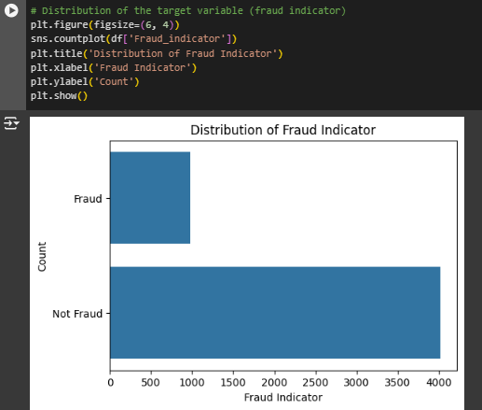
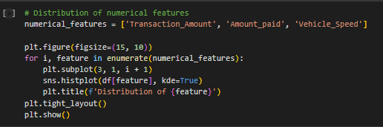
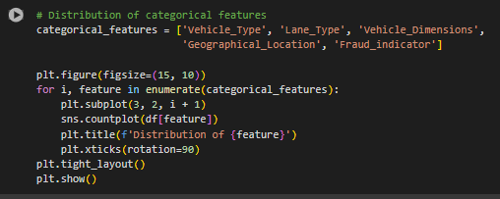
1. Data Exploration Visualization
+1

Slide 6

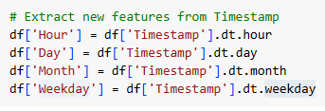



2. Feature Engineering
In this case we will Identify and engineer relevant features that contribute to fraud detection accuracy
There are several stages that need to be done
+5
+3

Slide 7



NEXT
+5
+3

Slide 8
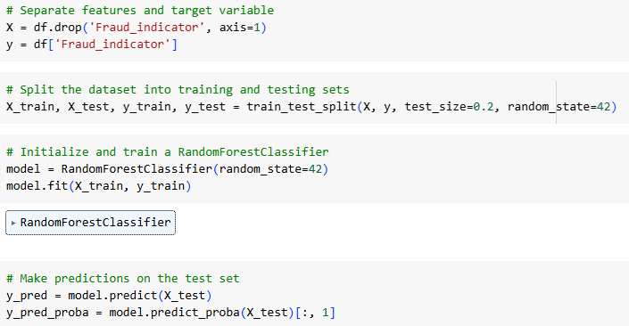
3. Model Development
Two Things that We have in this part :
Build a machine learning classification model to predict and detect Fastag transaction fraud.
Evaluate and fine-tune model performance using appropriate metrics.
+5
+3

Slide 9
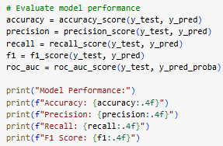
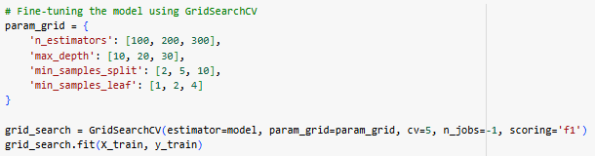

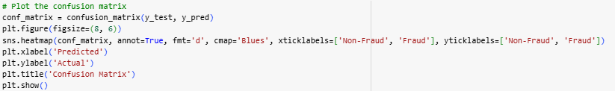
NEXT
For MODEL PERFORMANCE
+5
+3

Slide 10
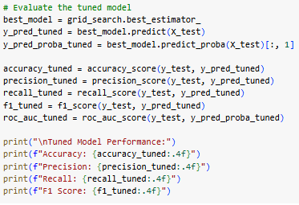

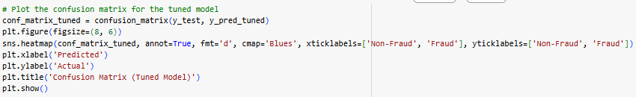
NEXT
For TUNED MODEL
+5
+3

Slide 11

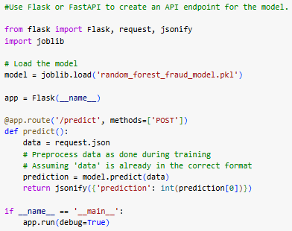
4. Real-time Fraud Detection
Explore the feasibility of implementing the model for real-time Fastag fraud detection.
+5
+3

Slide 12
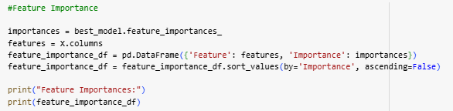
5. Explanatory Analysis
+5
Provide insights into the factors contributing to fraudulent transactions.
+3

Slide 13
Thank You
0
+4

